Slide 1

Real Estate Website
Project
Your Gateway to Buying, Selling, and Renting Properties
Group Members:
1.Ameer Muawia
2.Sohaib Hassan
3.Shahzaib
4.Saim
5.Saad

Slide 2
Objectives
1. Build a user-friendly real estate website
2. Showcase properties with detailed information and visuals
3. Implement contact form for queries
4. Provide live demo and accessible GitHub link

Slide 3
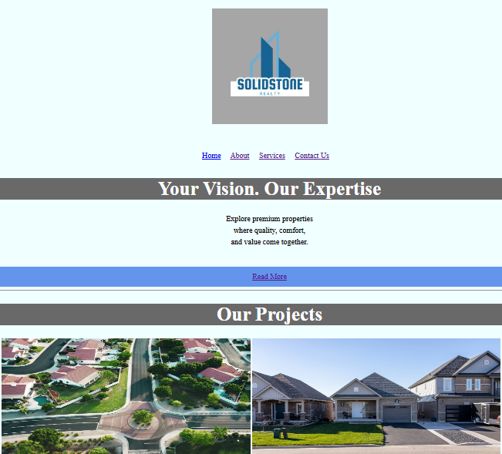
Home Page Overview
Features:
1.Pictures and Videos for visual representation
2.About key for customers to see our projects
3.Services key for visiting properties and houses on sale
4.Contact key for queries and questions about properties on sale
Description:
Our Website homepage is user-friendly and easy to use and access where everyone can visits in search of better houses on very affordable prices. It is composed of features which I already mentioned above.

Slide 4
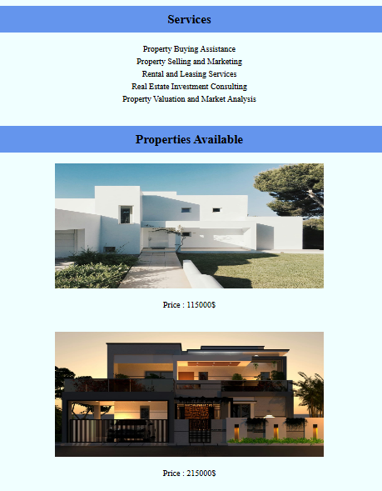
Services Page
Features:
1.Property images
2.Description about the properties
3.Prices of the properties
4.User friendly navigation for easy use

Slide 5
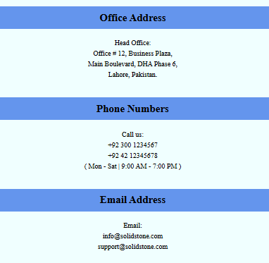
Contact Page
Features:
1.Contact form for queries
2.Live locations of our offices
3.Agents contact numbers for inquiries

Slide 6
Property Data Overview
Key Highlights:
1.Type of property like house or apartment.
2.Location of property like city center or downtown.
3.Price of the property.
4.Status like for sale or for rent.

Slide 7
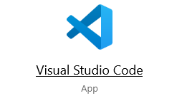

Design and Development Choices
Layout:
Clean and responsive design
Color Scheme:
Modern and appealing
Tools:
HTML, CSS, GitHub Pages for hosting

Slide 8
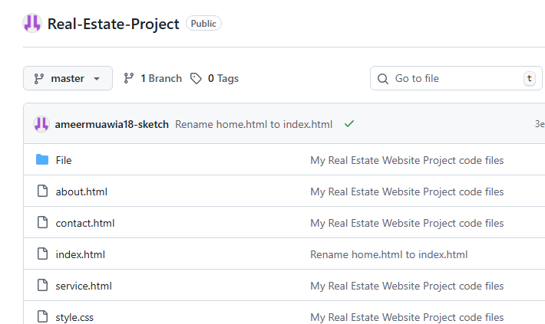
Live Demo & Source Code
Live Website Link:
https://ameermuawia18-sketch.github.io/Real-Estate-Project/
GitHub Repository:
https://github.com/ameermuawia18-sketch/Real-Estate-Project

Slide 9
Reflections and Future Plans
Challenges:
Ensuring responsive design, linking Excel data
Achievements:
Functional website, Dynamic data display, Professional layout
Next Steps:
Add more property filters, Improve User Interface, Add user login

